Slide 1
Omt postgraduate scholarships explained
Stride Shift
November 2025

Slide 2
Process flow

Slide 3
Application process flow
OMT board considers applications and approves / declines
Internal review – eligibility; completeness and accuracy
Not eligible
Approved
Draft
Submitted
Board meeting
Revisions Req
Under review
Declined
Declined
External reviewers score on adjudication activity
OMT shortlists for Board

Slide 4
Application specifics

Slide 5
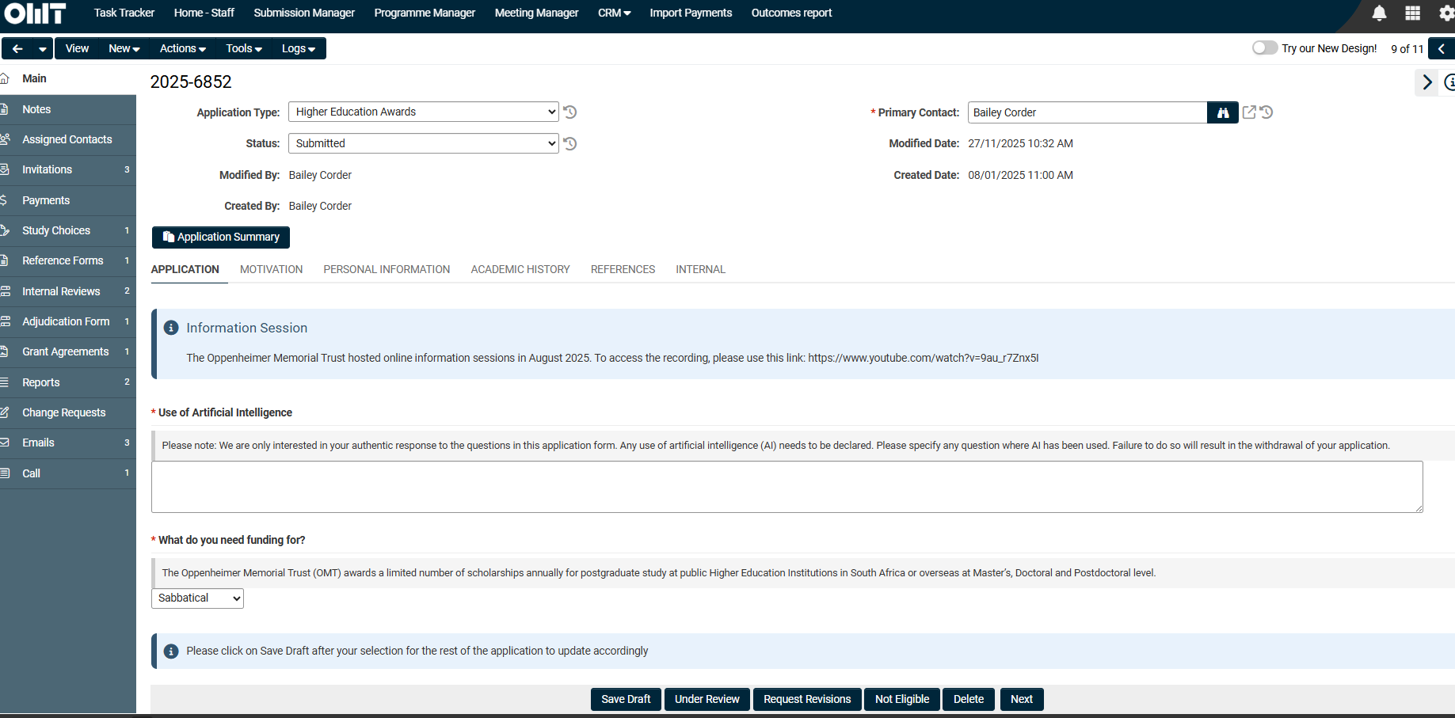
Navigating the application
The SmartSimple portal has the following 5 sections that are filled in by the applicant. Any field that is on the “home” page is a level 1 field and can be pulled into a report in the submission manager (Grant) filter. The sections on the left hand side are called activities and are level 2 fields. These fields can be pulled into a report in the submission manager (Activities) filter.
Level 2 fields – submission manager (Activities)
Level 1 fields – submission manager (Grants)

Slide 6
Navigating the application
The SmartSimple portal has the following 5 sections that are filled in by the applicant. Any field that is on the “home” page is a level 1 field and can be pulled into a report in the submission manager (Grant) filter. The sections on the left hand side are called activities and are level 2 fields. These fields can be pulled into a report in the submission manager (Activities) filter.
application
motivation
Personal info
Academic hist
references
Applicants to provide the below:
Level of funding (Masters, PhD, Postdoc or Sabbatical).
Local (SA) or international programme
Faculty
These 3 choices affect various questions (via dynamic fields) later on in the application
Choice of study table
Here, applicants provide detail on:
Study choice, including start date, duration, topic
Intended study: some text fields where students provide detail on their topic, methodology and approach. These fields are reviewed by OMT before going to external reviewers
Budget: dynamic fields for years, currency etc
Text box field
This question differs according to Masters / PhD or postdoc / sabbatical
Personal and demographic information including race, gender, nationality etc
Uploads for:
  CV
  Photo
  Passport / ID
  Publication history (sabbatical)
  NRF rating and research metrics (sabbatical)
Applicants fill out the table for academic history
Uploads for:
  Academic transcripts
  Degree certificates
There is a field for accolades too (textbox)
This section is optional for sabbaticals
Applicants populate a table for 3 references
Once complete, the portal sends an email with a link for the reference to upload the letter directly
Progress can be seen underneath this table
The actual letters can be seen on the reference letter activity on the left hand panel

Slide 7
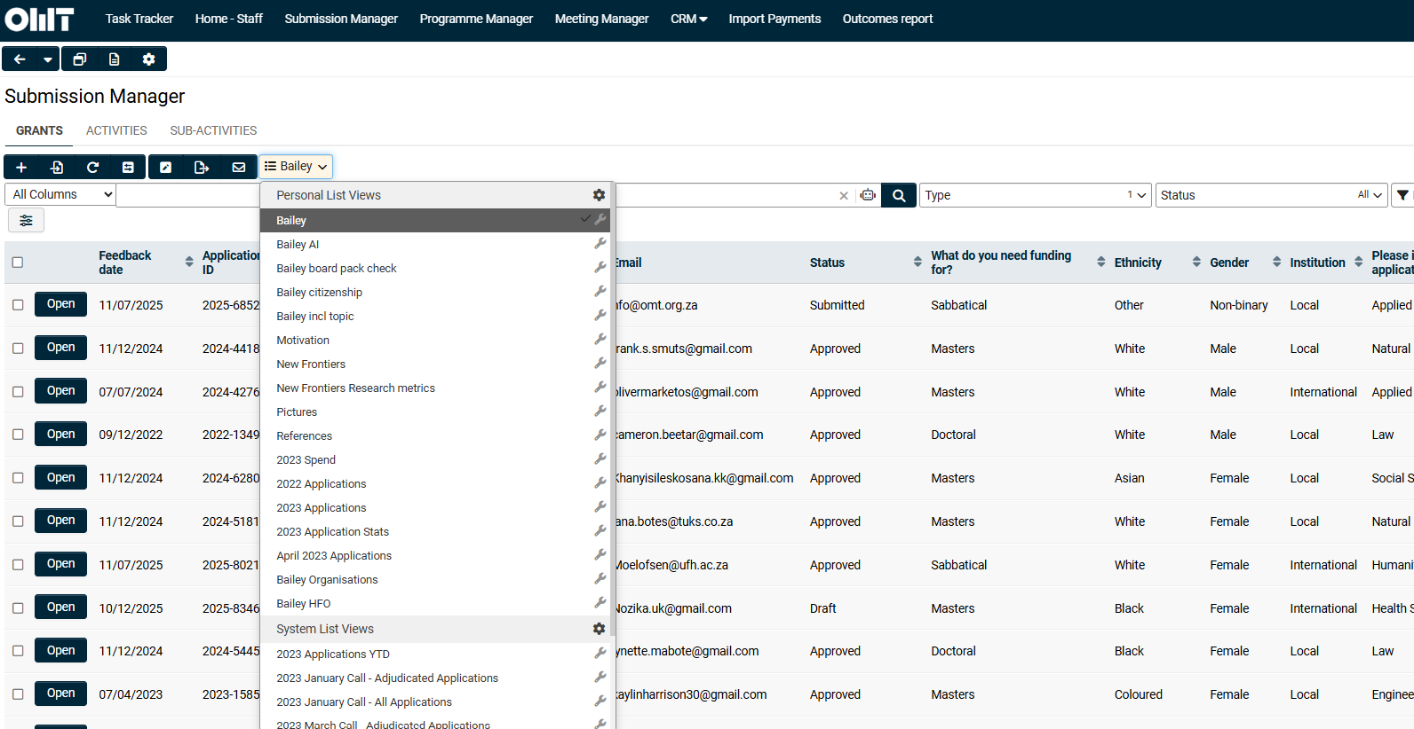
Working with a specific cohort
As the SmartSimple portal houses all information across programmes and calls, I usually export the relevant cohort data into excel as follows:
On the submission manager tab (Grants), select the Bailey filter and ensure the Type is set to Higher Education Awards only
Export to excel. The Application ID is the unique identifier that you will use for the other exports. The Feedback Date is relevant for a specific cohort, so remove all other cohorts accordingly.
Export here

Slide 8
Internal review

Slide 9
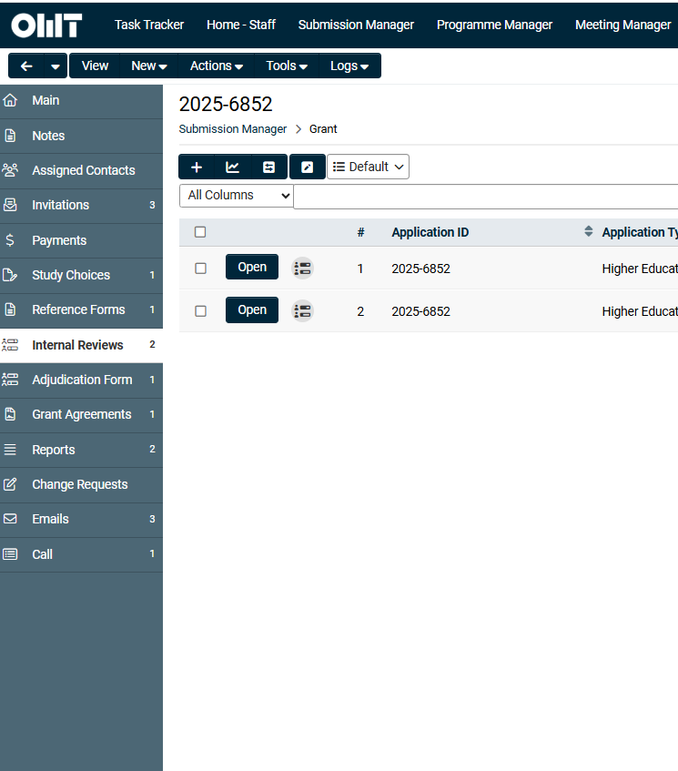
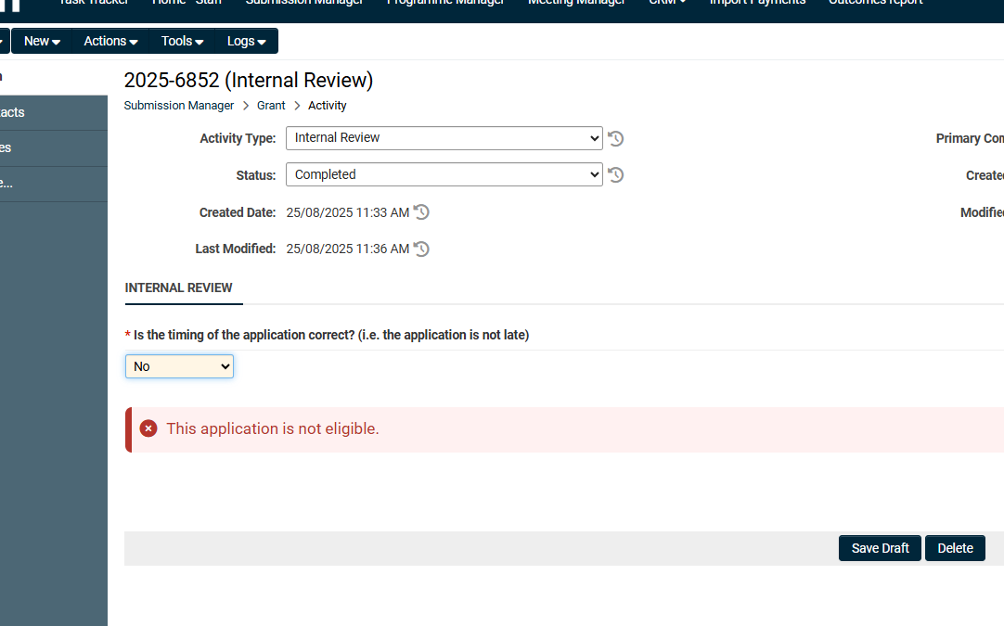
Internal review
Once an application is submitted by an applicant, an internal review activity is generated on the left hand panel
OMT staff manually complete this assessment which contains eligibility, as well as completeness & accuracy questions
If an application is not eligible, the internal review will reflect this and the application can be moved to “not eligible” status
If an application is missing information, OMT staff will reopen the application, using the revisions requested function. The application will be sent back to the candidate for them add the missing info.
Once the application is submitted again, a new internal review activity will appear.
This activity must be completed to move to the next status – either under review or not eligible. (only 1 needs to be completed)

Slide 10
eligibility

Slide 11
Eligibility criteria
We have some basic eligibility criteria that is looked at first. Applications that are not eligible will be marked as such on the internal review and the status will move to “Not eligible”
timing
Type of application
Commercial programmes
OMT does not consider applications for Masters study where students have already commenced their academic year
However, we will consider applications for the second year of study (or third for PhDs)
Therefore for timing, the start date field is exported
For the March call
  Eligible start dates are July – December of that year
For the August/September call
  Eligible start dates are January – June the following year
OMT starts funding only from the Masters level
Therefore, any undergraduate, honours, diplomas etc are not eligible
As applicants have to select the type of application from a drop down, this information is usually found in the study choice table
For Masters students: OMT funds only a student’s first Masters – therefore they must not already hold this degree
OMT does not fund:
  MBAs
  DBAs
  Commerce programmes such as: finance, HR, organisational psychology, IT etc
  Commercial law
  Commercial/straight Engineering
This is at the discretion of Tracey/Bailey and the information can be found in the study choice table

Slide 12
Internal review: eligibility
Question | Where to look | Action required
Is the timing of the application correct? (i.e. the application is not late) | Application → Choice of study → Open table → look to question “Please indicate the start date of your programme” | These are our basic eligibility criteria. This information can be exported to look at in a complete database (see slides that follow). If any of these eligibility criteria are not met, the rest of the assessment is not performed.
Is the type of application accurate? (i.e. not an honours, diploma, etc) | Application → First question being “What do you need funding for?” Corroborate by looking here: Application → Choice of study → Open table → Choice of Study
Is the applicant studying an MBA, DBA or a programme with a narrow commercial focus? | Application → Choice of study → Open table → Choice of Study
Does the applicant already have a Masters (Masters only) | Academic history → check the table as well as the uploads Personal information → CV may also contain this information
Has the applicant entered their email address for a referee? | For applicant email: Personal information → email address For referee email: References → look into reference table | Reference letters must be received directly from Referees – we cannot accept any letters that are uploaded by the student themselves. If duplicate / own email address are used, OMT staff will: Delete the record and use “Request revisions” or notes (if it is not submitted) and request the applicant to fill in the correct information The applicant may send you the information if they are unable to update themselves.
Has the applicant submitted duplicate referee details? | References → look into reference table

Slide 13
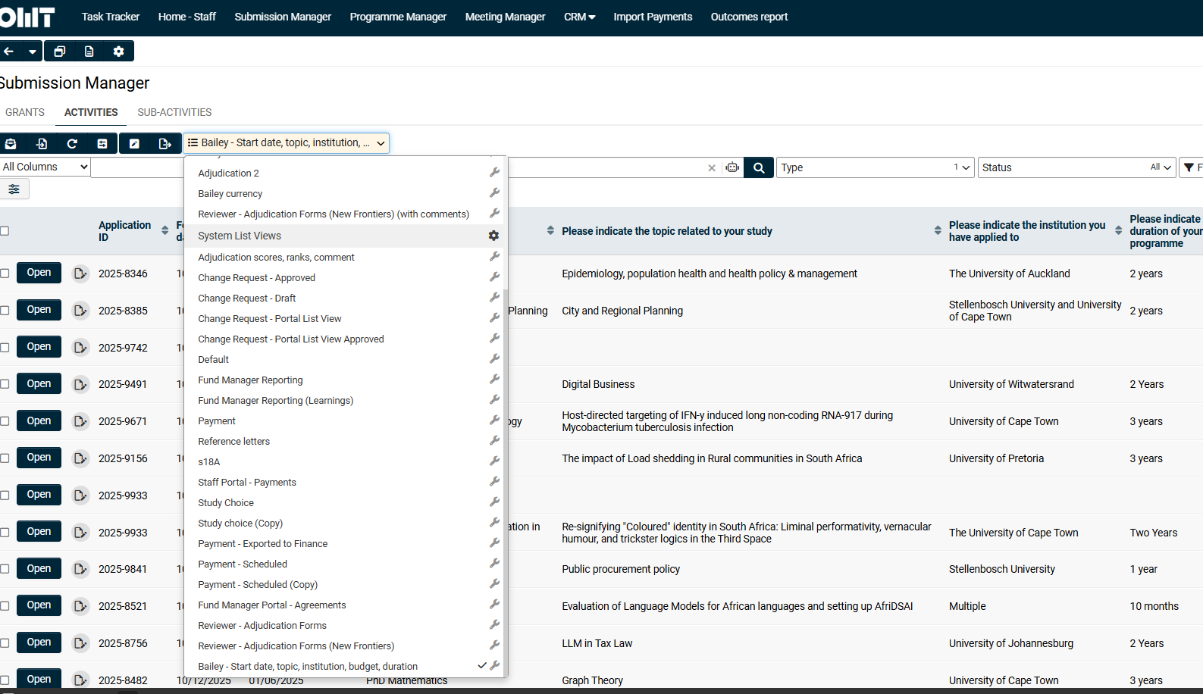
Determining eligibility
I have created a study choice filter which can be easily exported to excel
Navigate to the Submission Manager tab, Activities
On the filter drop down, select Bailey – start date, topic, institution, budget, duration. Make sure study choice is selected under type
You will be able to add this data to the initial cohort data that you pulled, using the Application ID as the unique field
To export, click here

Slide 14
Completeness and accuracy

Slide 15
Internal review: completeness and accuracy
Students will not be able to submit unless all mandatory sections have been completed. Therefore, we don’t check text boxes for completeness and accuracy, but the focus here is checking uploads to ensure they are correct, and we are able to download / open the document.
The portal allows for 2 actions:
Request revisions: this sends the application back to the student so they can add / amend information.
Write the student a note: this is done on the left hand activity panel (right at the top). This sends an email to the student and they are able to reply. Notes are used when we need to ask them a question, or remind them about something (usually reference letters), but it does not require the student to edit any info.
Question | Where to look | Action required
Does the application have 3 completed reference letters? | Reference forms (left hand panel) → here please check that there are 3 submitted references forms from 3 different referees | Please use the “Notes” function to communicate where reference letters are still outstanding
Is the CV attachment correct and readable? | Personal information → scroll to the bottom of the page and open the document | Request revisions where the document is incorrect / unreadable This is done via the Internal Tab (on the application main page – on the right hand side). OMT staff fills in the text box which is then added to the email communication to the student so they know what / how to amend the application. This effectively changes the status to draft again.
Is the photograph attachment correct and readable? | Personal information → scroll to the bottom of the page and open the document
Is the ID / residence permit / passport attachment correct and readable? | Personal information → scroll to the bottom of the page and open the document
Is the academic transcript attachment correct and readable? | Academic history → attachment under “Academic Transcripts” Please ensure the table and the uploads correspond to each other
Is the degree attachment correct and readable? | Academic history → attachment under “Certified copies of your degree(s)” Please ensure the table and the uploads correspond to each other
Has the student completed the budget for all corresponding years of study? | Application → Choice of study table → Open → Budget Please check that the student has filled in the correct amount of columns to the question “How many years do you require funding for?” | Request revisions asking the applicant to fill in the budget correctly I.e. if they have requested funding for 3 years, please ensure the budget is complete for all 3 years
Are all 3 reference letter attachments correct and readable? | Reference forms (left hand panel) → “Open” → click on document under “File name” to open | Use the “Notes” function to communicate to the applicant BC note: this question is a repeat / slightly redundant to the top one but included for completeness.

Slide 16
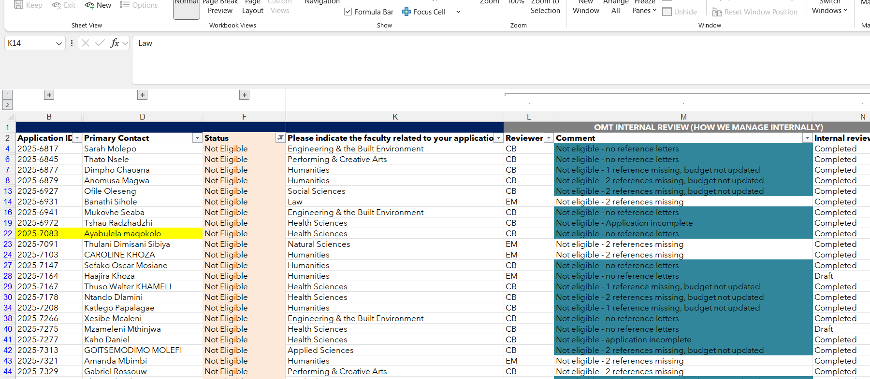
August example
On the attached excel document, filter for status “not eligible” (column F)
Column N has the reason for ineligibility with typical reasons being:
Application incomplete (mainly due to references being missing – we will accept a minimum of 2 references)
Honours programme
Late – see timing rules
Topic N/A

Slide 17
Defining faculties

Slide 18
Batching faculties
Faculty | Typical topics
Applied Sciences | Chemistry Physics Maths and Applied Maths Data Science, AI, Machine Learning
Commerce | Development Finance Economics (usually with a development lens)
Engineering & the Built Environment | Engineering Architecture Built Environment
Health Sciences | Public Health Pharmacy Human element (as opposed to plants)
Humanities / Social Sciences | Education Philosophy Politics
Law | Human Rights Public interest Climate / conservation
Natural Sciences | Zoology Climate change / conservation Animal Sciences Plant Sciences
Performing & Creative Arts (Must have performing lens) | Music Theatre & Performance (Drama, Dance) Visual and Creative Arts
Students self-select their faculty when completing their application.
Many universities view these groupings differently, so we usually go through these manually, looking at the study choice and topic and batch them accordingly.
This is done to ensure the most appropriate reviewer adjudicates the application.
I have included typical topics to demonstrate how we do this.
More detail is included in the excel example.
I usually export the study choice / topic information using the Bailey – start date, topic, institution, budget, duration filter – see slide above
There can often be confusion between Health and Natural Sciences.
Health we include topics with human focus. Natural will include topics with plant focus.
Chemistry and Physics is allocated to Applied Sciences
Performing Arts must have a performing lens. Theoretical / more research focused topics are usually allocated to Humanities / Social Sciences

Slide 19
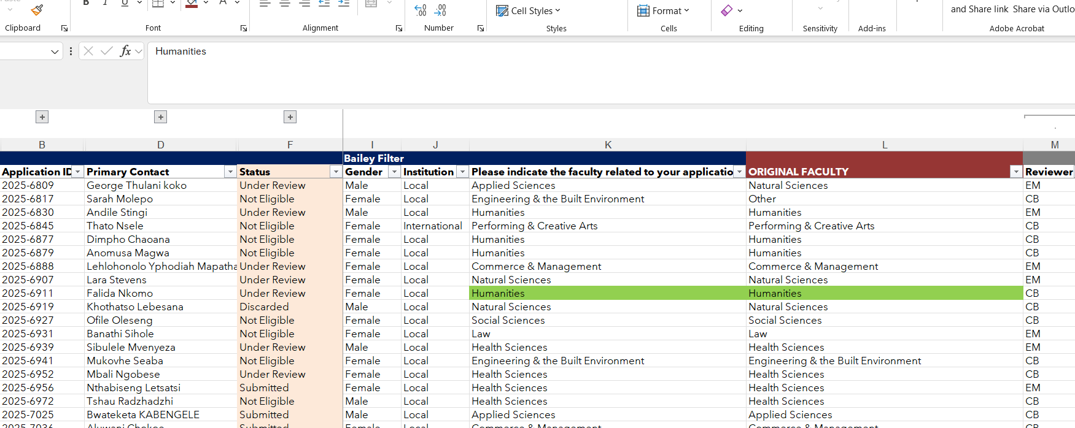
AUGUST EXAMPLE
In the August call excel doc, you will see the OMT faculty in column K and the original faculty in column L to compare the differences
Use the study choice and Topic to assist you here (columns Q and R)

Slide 20
Weak answers to intended study

Slide 21
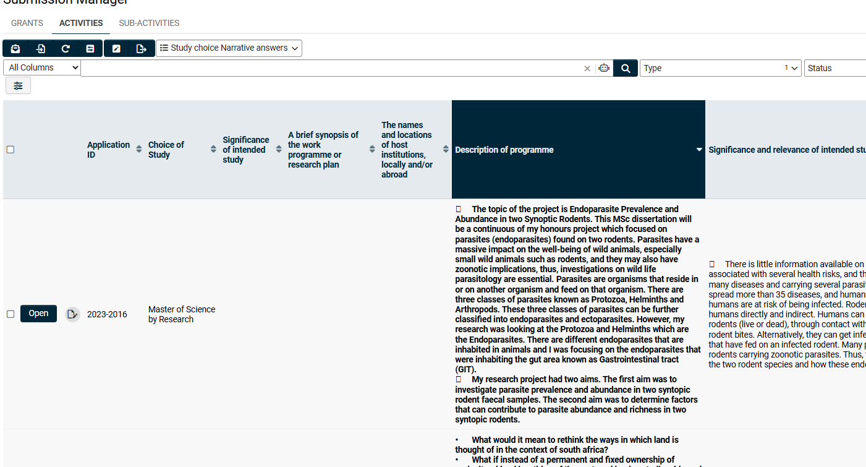
Weak answers discarded
Beyond the basic eligibility, we don’t usually moderate answers received from students.
However this round, Tracey and I reviewed the answers to the choice of study questions:
Masters and PhD:
  Description of programme
  Significance and relevance of intended study
Postdoc and sabbatical
  Significance of study
  Synopsis of work programme
  Host institutions
To view the answers to these questions, I have created another list view, called Study Choice Narrative answers
Navigate to Submission Manager – Activities and select the filter called Study Choice Narrative answers. Make sure study choice is selected under type and you can export to excel

Slide 22
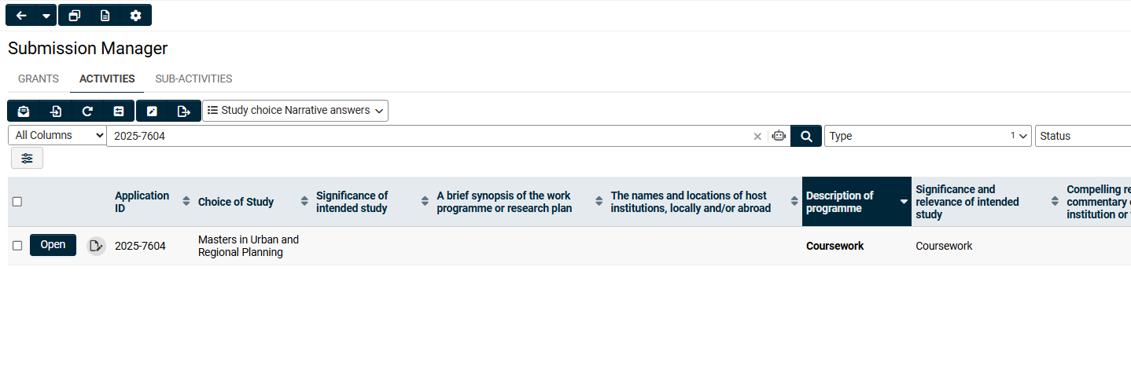
August example
To find examples of how we determined this, please navigate to the August 2025 Applications excel file.
In column F, filter for status type “Submitted”
These applications were not sent for external review and we moderated them internally
An example is application 2025-7604 – you can clearly see that they have made no attempt to answer this question well.
We had a look at the topics and how these questions were answered to get the batch down to a suitable size.

